Slide 1

Data Analytics Portfolio
Analysis by: Silvana Escamilla Gutierrez
silvanaescamilla@gmail.com
www.linkedin.com/in/silvana-gutierrez

Slide 2
Projects
Game Co.
Preparing for Influenza Season
Rockbuster Stealth
Analyzing global video game sales
Medical Staffing Analysis
Answering business questions for an online video rental company
Instacart
Marketing strategy for an online grocery store

Slide 3
GameCo.

Slide 4


GameCo. | Video Game Sales Analysis
Project Overview
GameCo. is a new video game company that is interested in using data to influence the development of new games and how these game will perform in each market.
Key questions and objectives
How have their sales figures varied between geographical regions over time?
Have any games decreased or increased in popularity over time?
Are certain types of games more popular than others?
Data Set
VGChartz​. : Data covers historical sales of video games spanning different platforms, genres, and publishing studios.
Tools
Skills
Grouping data
Summarizing data
Descriptive analysis
Visualizing results in Excel
Presenting results

Slide 5
Regional Sales by Units – 80% drop in global sales
Interestingly, the sales after 2009 began to decline in all regions
You can see how even the most dominating region, North America, had less unit sold in 2016 than Europe.
Inferences:
Global financial crisis after 2008.
Boost in online games
Europe Sales underperformed compared to Japan and the North American, but their unit sales began to surpass Japan’s Sales after 1996.
The graph shows how sales across all of the regions have not remained the same over time.
Notes:
Call out. Key message for each slide. Ex. Sales fell 80%from 200-2016 (example GameCo.)

Slide 6
2016 Top Global Sales
In 2016, the top four global sales by genre are:
Action
Shooter
Sports
Role-Playing

Slide 7
Recommendations
Based on the analysis provided the recommended approach would be to allocate marketing dollars based on the market share by region in 2016.
In addition to looking at the percentage of global sales, I recommend allocating the marketing dollars based on the top four genres that make up the sales in 2016.
Action
Because the percentage of global sales are almost evenly distributed by regions, marketing dollars should be distributed equally among the three region.
Shooter
Invest marketing dollars in Northern America and Europe as they make up 83% of global sales
Sports
Invest marketing dollars and North American and Europe. I believe there’s an opportunity to expand market share in North America by investing in this genre.
Role-Playing
Japan has nearly 54% of market share. Continue to invest marketing dollars in this genre.
Other genres to consider in the future:
Fighting in all three markets.
Recommended Marketing Investment by Genre
Europe
Racing
North America
Shooter
Sports
Japan
Simulation
Fighting
Shooter
Sports
Role Playing
Misc
Action
Action
Action

Slide 8
Preparing for Influenza Season

Slide 9

Preparing for Influenza Season | Medical Staffing Analysis
Project Overview
Motivation: The United States has an influenza season where more people than usual suffer from the flu. Some people, particularly those in vulnerable populations, develop serious complications and end up in the hospital. Hospitals and clinics need additional staff to adequately treat these extra patients. The medical staffing agency provides this temporary staff.
Objective: Determine when to send staff, and how many, to each state.
Scope: The agency covers all hospitals in each of the 50 states of the United States, and the project will plan for the upcoming influenza season.
Hypothesis:. If a state has large numbers of vulnerable populations, then more patients will be admitted to the hospital due to influenza
Data Sets:
Influenza deaths by geography, time, age, and gender
Population data by geography
Counts of influenza laboratory test results by state (survey)
Links
Tools
Skills
Tableau Presentation
https://public.tableau.com/app/profile/silvana5708/viz/InfluenzaDeathsbyYears-2_4/FinalProject2_9
Video Presentation
https://vimeo.com/627873776/0d91d71e43
Data cleaning
Data integration
Data transformation
Statistical hypothesis testing
Storytelling in Tableau

Slide 10
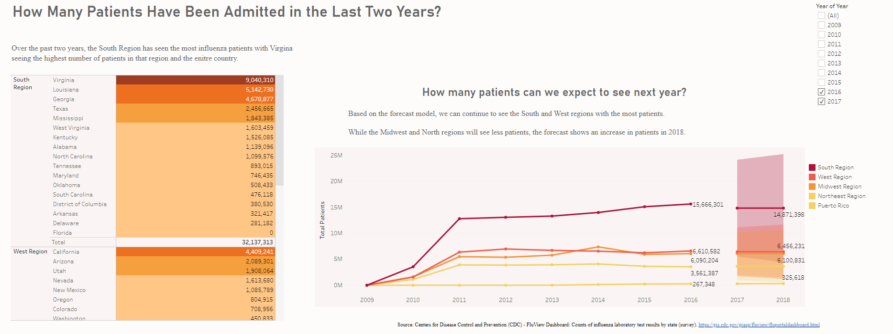
How Many Patients have Been Admitted in the last two Years?

Slide 11
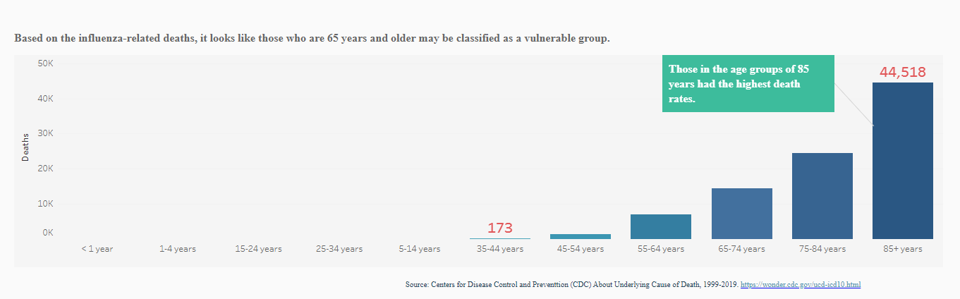
Relationship between deaths and vulnerable populations

Slide 12
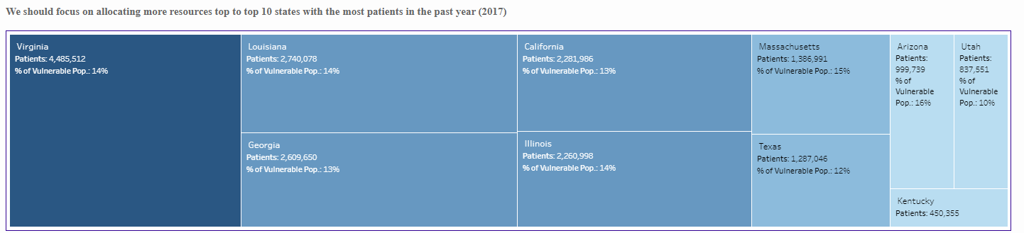
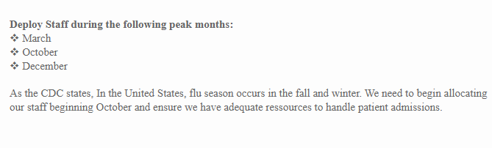
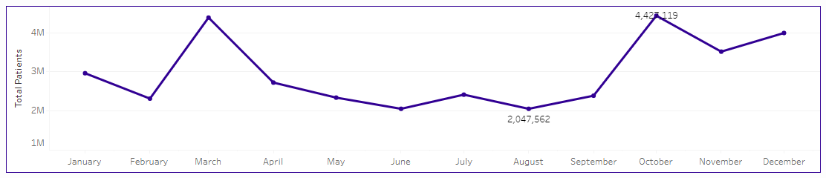
Recommendations for Staffing Allocation

Slide 13
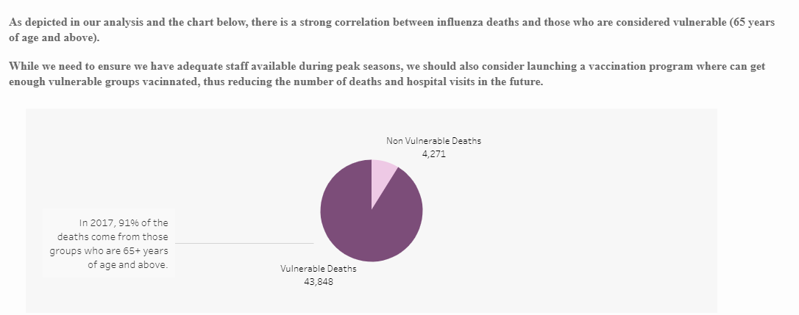
Recommendations for vulnerable populations

Slide 14
Rockbuster Stealth

Slide 15


Rockbuster Stealth |Online Video Rental Analysis
Project Overview
Rockbuster Stealth LLC is a movie rental company that used to have stores around the world. Facing stiff competition from streaming services such as Netflix and Amazon Prime, The Rockbuster management team is planning to use its existing movie licenses to launch an online video rental service in order to stay competitive.
Key Questions
Which movies contributed the most/least to revenue gain?
What was the average rental duration for all videos?
Which countries are Rockbuster customers based in?
Where are customers with a high lifetime value based?
Do sales figures vary between geographic regions?
Data sets: Contain information about Rockbuster’s film inventory, customers, and payments
Download the Rockbuster data set
Download PostgreSQL Database
Links
Tools
Skills
Tableau Presentation
https://public.tableau.com/shared/J23BYCD9P?:display_count=n&:origin=viz_share_link
SQL Queries GitHub Repository
https://github.com/SEG-Page/SQL-Queries
Database querying
Filtering
Cleaning and summarizing
Joining tables
Subqueries
Common table expressions

Slide 16
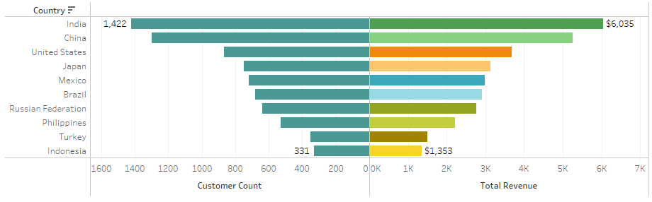
Customers by Country
SQL Query – Subqueries
SELECT country,
COUNT(customer.customer_id) AS customer_count,
SUM(payment.amount) AS total_payment,
DATE(rental_date)
FROM customer
INNER JOIN address ON address.address_id = customer.address_id
INNER JOIN city ON city.city_id = address.city_id
INNER JOIN country ON country.country_id = city.country_id
INNER JOIN payment ON payment.customer_id = customer.customer_id
INNER JOIN rental ON rental.customer_id = customer.customer_id
GROUP BY country, DATE(rental_date)
As we begin to launch the online platform, we need to develop a marketing strategy to target the top 5 countries listed above.
We also need to consider if there are any Government restrictions that will prevent us from entering markets.

Slide 17
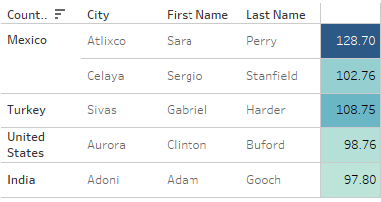
Top 5 customers
It’s no surprise that our top customers are also located in the top countries that bring in the most revenue.
Mexico has two customers in fact.
SQL Query – Subqueries
/*Top 5 customers*/
SELECT A.customer_id,
B. first_name,
B. last_name,
D.city,
E.country,
SUM(A.amount) AS total_amount_paid
FROM payment A
INNER JOIN customer B ON A.customer_id = B.customer_id
INNER JOIN address C ON B.address_id = C.address_id
INNER JOIN city D ON C.city_id = D.city_id
INNER JOIN country E ON D.country_id = E.country_id
WHERE city IN ('Aurora', 'Atlixco', 'Xintai','Adoni','Dhule (Dhulia)', 'Kurashiki', 'Pingxiang', 'Sivas', 'Celaya', 'So Leopoido')
GROUP BY A.customer_id, B. first_name, B. last_name, D.city, E.country
ORDER BY total_amount_paid DESC
LIMIT 5

Slide 18








Recommendations
Over the past few months, brick and mortal sales have been declining. Now is a good time to consider offering online streaming services.
India, China, United States, and Mexico not only had the highest customer count, but also brought the most revenue.
Consider launching services to these customers, but Government restrictions may be a factor.
Movie genres such as Sports, Animation, Drama, and Sci-Fi are the most popular films. Having an inventory or contracts with such production companies will be key to launch.
Offer our top 5 clients first access to the platform. Provide a complimentary subscription for 60-90 days, but offer feedback on user experience.

Slide 19
Instacart

Slide 20

Instacart | Online Grocery Sales Analysis
Project Overview
Instacart, is an online grocery store that operates through an app. The stakeholders are most interested in the variety of customers in their database along with their purchasing behaviors. They assume they can't target everyone using the same methods, and they’re considering a targeted marketing strategy.
Key Questions
The sales team needs to know what the busiest days of the week and hours of the day are in order to schedule ads at times when there are fewer orders.
They also want to know whether there are particular times of the day when people spend the most money, as this might inform the type of products they advertise at these times.
The marketing and sales teams are particularly interested in the different types of customers in their system and how their ordering behaviors differ.
Data Sets: Order, geographical information, products sold
Customers Data Set - https://www.instacart.com/datasets/grocery-shopping-2017 on November 19, 2021
Data Dictionary
Links
Tools
Skills
Python Codes GitHub Repository
https://github.com/SEG-Page/Python-Code
Data wrangling
Data merging
Deriving variables
Aggregating data
Reporting in Excel
Population flows

Slide 21
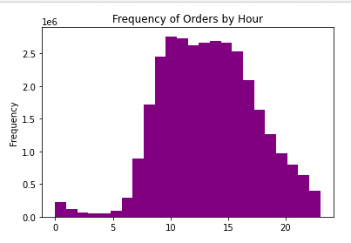
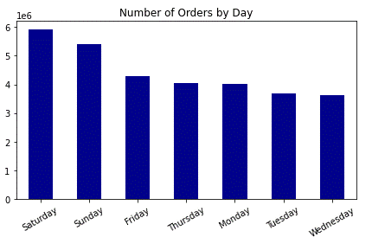
The sales team needs to know what the busiest days of the week and hours of the day are in order to schedule ads at times when there are fewer orders.
Orders by Day
Most orders are placed on the weekend
Orders by Hour
The histogram shows that most orders are placed from 10am-12pm. However, in the hours from 1-3pm you can also see that there are a lot of orders placed.

Slide 22
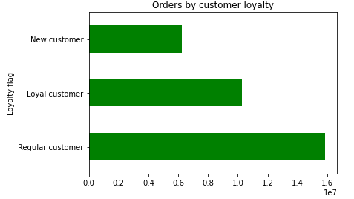
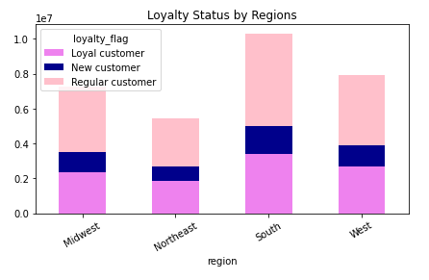
Are there differences in ordering habits based on a customer’s region and status?
Brand Loyalty: Most customers are regular customers - those who have placed 15-40 orders followed by loyal customers who have placed more than 40 orders.
Brand Loyalty and Regions: Instacart is performing well in the South Region. The West and Midwest are performing fairly well. However, the Northeast can use a boost in sales.

Slide 23
Recommendations
Schedule ads on from Monday-Wednesday to attract more customers.
Special ads should also be pushed early in the morning as this is when customers do most of their shopping.
For loyal customers, the Instacart team should consider rewarding these customers. Perhaps offer free delivery or discount on their next orders.
For regular customers, consider activating a loyalty program where customers can subscribe to loyalty programs and get special offers each month.
Consider digital ads in the Northeast Region to promote Instacart in this region.
Because most customers are parents (75%), I would recommend launching digital ads on sites were parents visit.

Slide 24
U.S. Regional Sales Analysis

Slide 25
U.S. Regional Sales Analysis
Project Overview
In this case study we will be exploring the sales performance for a fictitious retail company in the United States. The company sells items such as Computers, Collectibles, Furniture and much more.
Key questions and objectives
Is there a relationship between the size of population and sales?
What is the most successful sales channel by region?
What region performed better?
Recommendations
Data Set
Data retrieved from Data.World (https://data.world/dataman-udit/us-regional-sales-data) – Sales Transactions by US regions.
Tools
Skills
Links
Python Codes GitHub Repository
https://github.com/SEG-Page/Python-Code
Visual Presentation: Tableau
https://public.tableau.com/views/Achievement6FinalProject/USRegionalSalesAnalyis?:language=en-US&publish=yes&:display_count=n&:origin=viz_share_link
Data wrangling
Data merging
Deriving variables
Statistical hypothesis testing
Regression analysis
Time-series analysis
Storytelling in Tableau

Slide 26
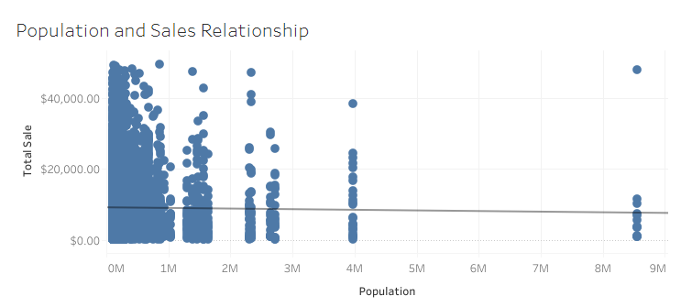
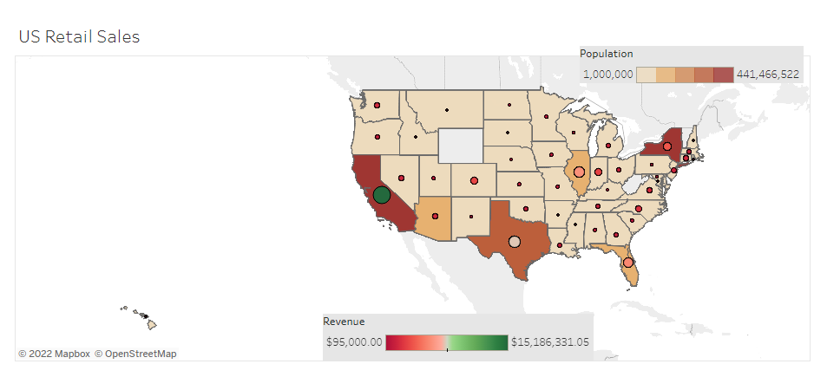
Exploratory Analysis
In my hypothesis, I stated that the higher the population, the higher the revenue the state would bring. However, based on the regression analysis, we can see that there is no relationship between population and sales.
To confirm that there was no correlation, I used spatial analysis to determine the total sales by state.
While California, Texas and New York are the most highly populated states, we can see on the map that only California had the highest revenue. Texas and New York brought modest revenue but almost the same range as other states.

Slide 27
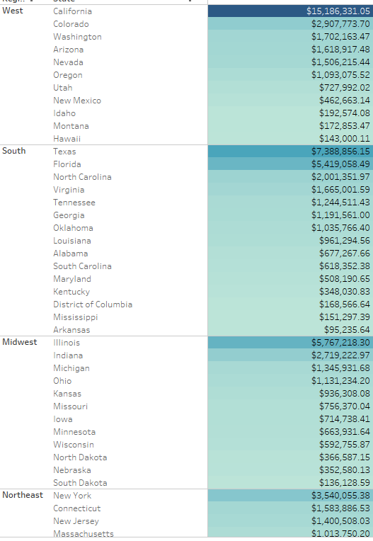
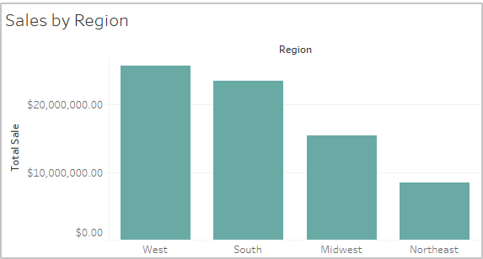
Regional Sales
While we couldn't find a correlation between population and revenue, I wanted to take a closer look at the performance of sales by region.
The West and South regions bring in the highest revenues. You can see that the Northeast is not performing well.

Slide 28
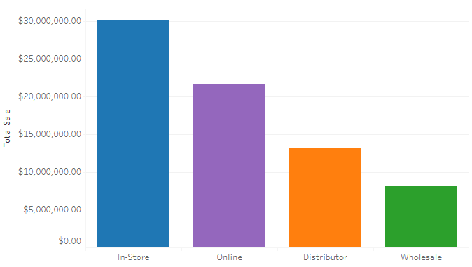
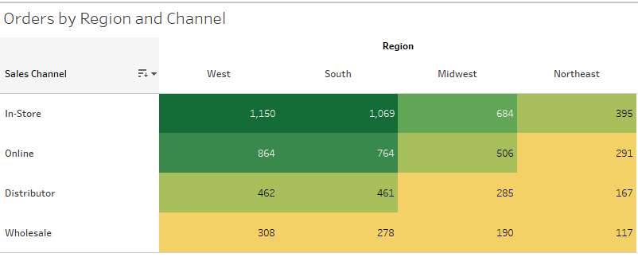
Distribution Channels
To further analyze the regional sales, we need to look at what sales channel contributed to the company's success.
In-Store shopping is still popular in most regions, but online shopping is beginning to ramp up.
We need to look at bumping in-store sales and online sales in the Midwest and Northeast.

Slide 29
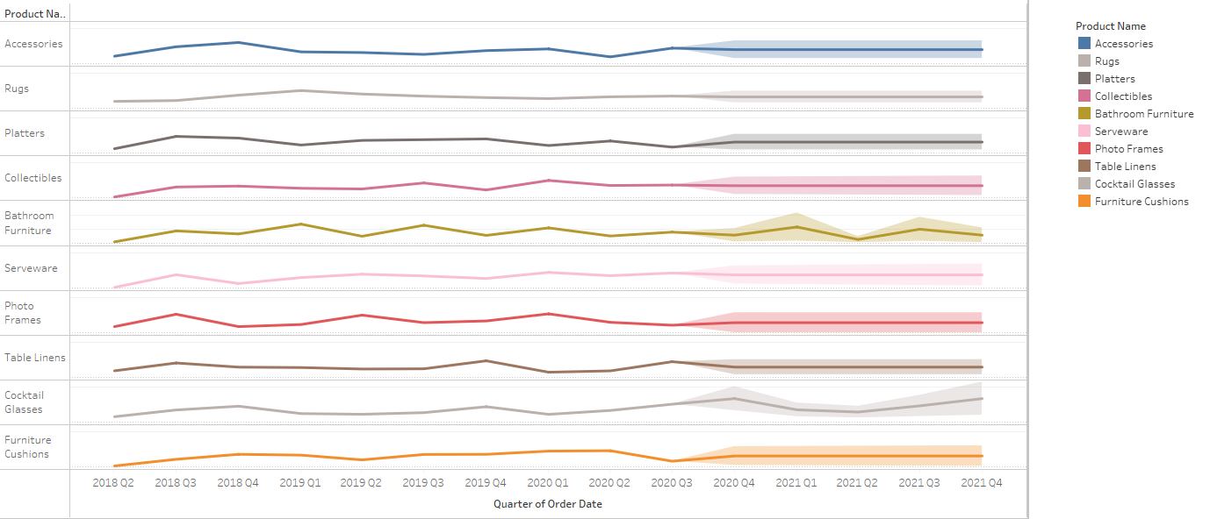
Historical Sales by Products
With regards to sales over time, I wanted to look at the historical sales by product. Accessories, rugs, and platters were the highest selling products. But looking ahead, based on the forecast, cocktail glasses may generate more revenue.

Slide 30
Recommendations and Insights
While we couldn’t find a relationship between population and revenue, we did uncover interesting insights.
The West and Southeast regions had the highest revenues.
The Midwest and Northeast regions have an opportunity to increase revenue by investing advertising dollars in the larger cities.
In-store shopping is the most popular form of shopping. Consider sending more sales teams to the Midwest and Northeast, especially in the larger cities.
Build an online presence, as most orders are also coming from this sales-channel.
Ensure there is enough inventory for the top selling products, but also look to increase inventory in cocktail glasses, as this product is forecasted to increase in sales.

Slide 31
Thank You

